Slide 1
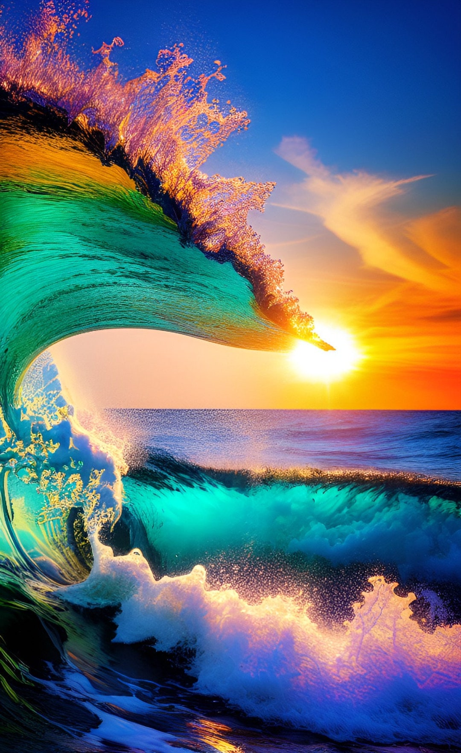
Ocean Exploration: Unlocking the Mysteries of the Deep
The ocean is a vast and mysterious realm, holding secrets waiting to be uncovered. Ocean exploration is a vital endeavor that expands our understanding of the planet and its diverse ecosystems.

Slide 2
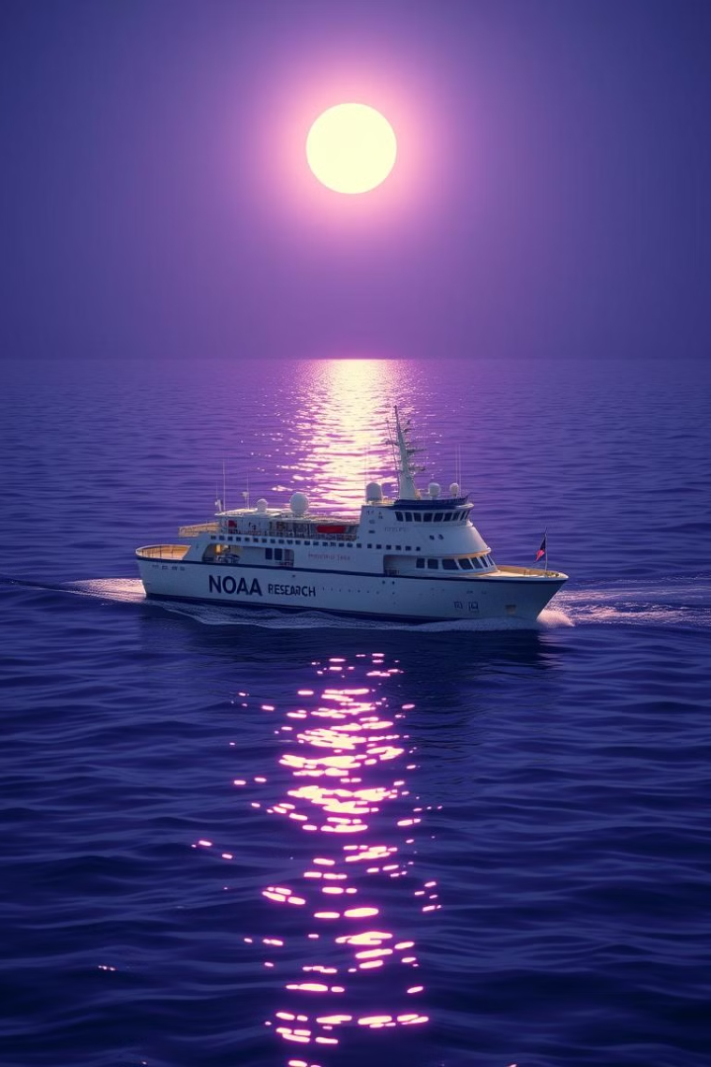
NOAA's Role in Ocean Exploration
1
Scientific Research
2
Data Collection
NOAA conducts research to understand the ocean's physical, chemical, and biological processes.
They gather data on oceanographic conditions, marine life, and environmental changes.
3
Mapping and Surveying
4
Conservation Efforts
NOAA protects marine habitats, manages fisheries, and works to ensure the sustainable use of ocean resources.
NOAA maps the seafloor and creates detailed charts for navigation and resource management.

Slide 3
The PACE Satellite: A Game-Changer for Ocean Monitoring
Multispectral Imaging
Climate Change Monitoring
Ocean Health Assessment
PACE uses six different spectral bands to collect data on ocean color, chlorophyll concentration, and other key factors.
PACE will provide valuable insights into how climate change is impacting ocean ecosystems.
The satellite will help scientists monitor the health of marine ecosystems and identify potential threats.

Slide 4
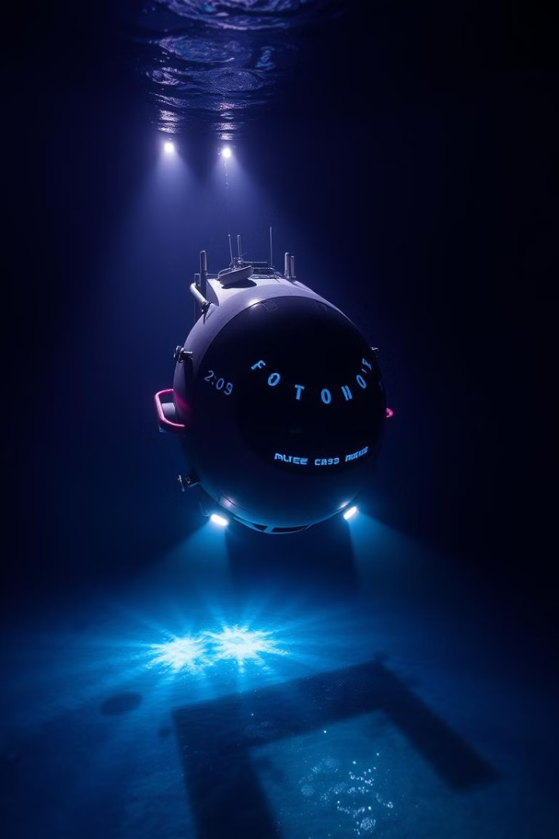



Exploring the Seafloor: Cutting-Edge Technologies
Autonomous Underwater Vehicles (AUVs)
These robots can explore the seafloor without human intervention, collecting data and imagery.
Remotely Operated Vehicles (ROVs)
ROVs are controlled by operators on the surface and can be used for detailed inspections and sampling.
Sonar Mapping
Sonar technology creates detailed maps of the seafloor, revealing underwater features and topography.

Slide 5
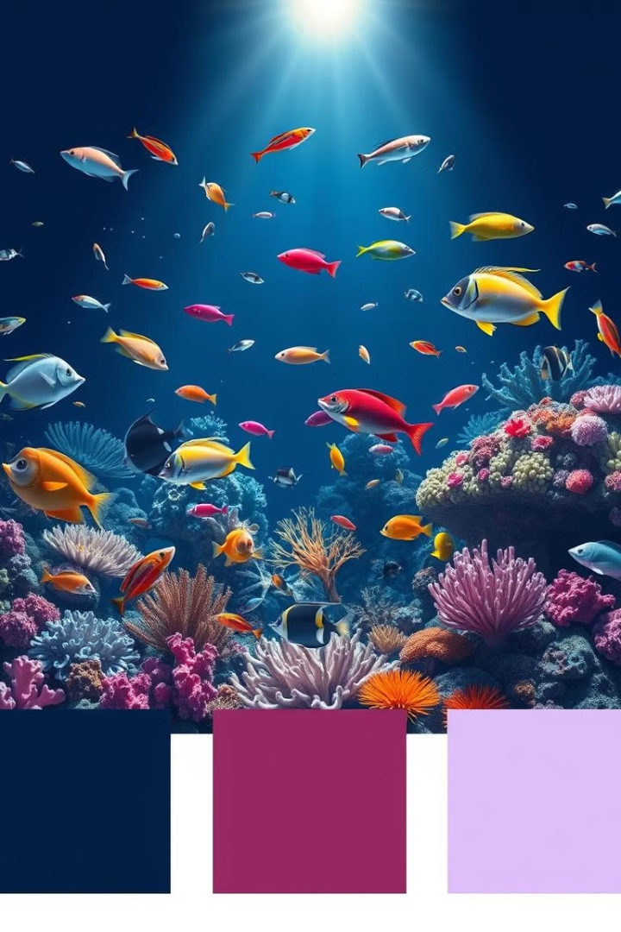
Discovering New Marine Species and Ecosystems
1
Deep-Sea Exploration
Advanced technologies have allowed scientists to explore the deepest parts of the ocean, discovering new species.
2
Genetic Analysis
DNA sequencing techniques are used to identify new species and understand their relationships.
3
Remote Sensing
Satellites and underwater drones provide a broader view of ocean ecosystems, revealing new areas of interest.

Slide 6
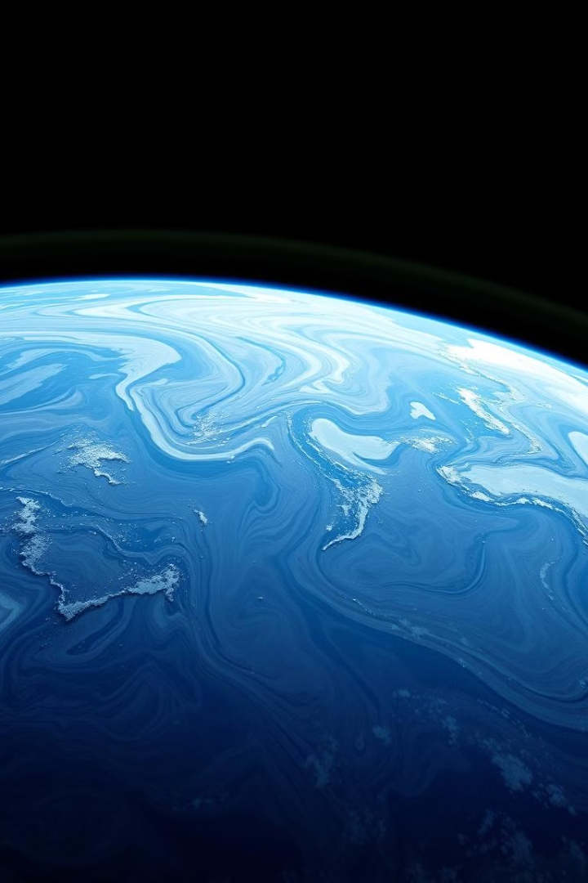
Uncovering the Impacts of Climate Change on the Oceans
Increased Ocean Temperatures
Coral bleaching and ocean acidification.
Sea Level Rise
Coastal erosion, flooding, and displacement of coastal communities.
Ocean Acidification
Impacts marine life, particularly shell-forming organisms.

Slide 7
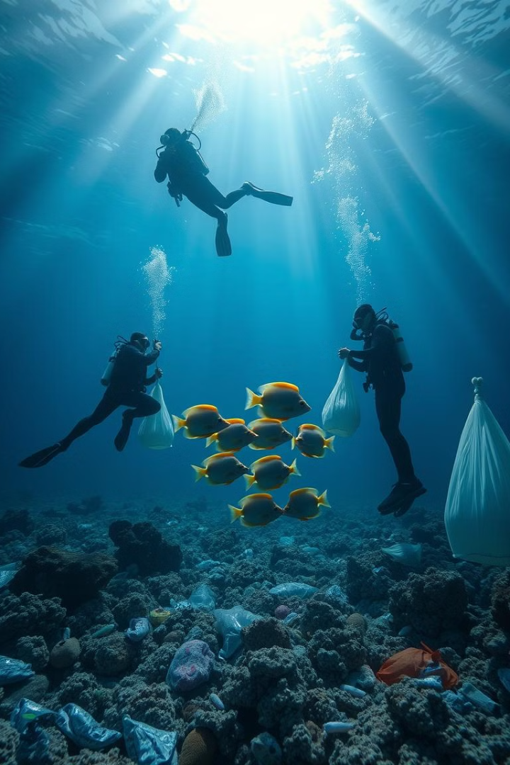




The Importance of Ocean Conservation and Sustainability
Reduce Pollution
Sustainable Fisheries
Minimize plastic waste and other pollutants entering the ocean.
Practice responsible fishing methods to ensure the long-term health of fish populations.
Climate Action
Marine Protected Areas
Reduce greenhouse gas emissions to mitigate climate change impacts on the ocean.
Establish protected areas to safeguard vulnerable marine ecosystems.

Slide 8
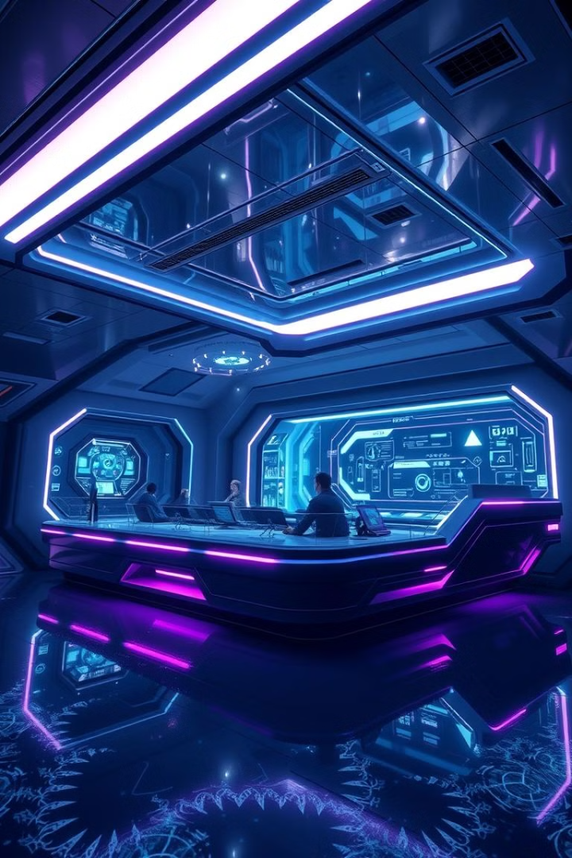
The Future of Ocean Exploration: Collaborations and Innovations
International Partnerships
Technological Advancements
Collaborations between countries are crucial for advancing ocean exploration and conservation.
Emerging technologies like AI and robotics will continue to revolutionize our ability to explore the ocean.
Citizen Science
Engaging the public in ocean research can help gather data and raise awareness about ocean issues.

